Slide 1
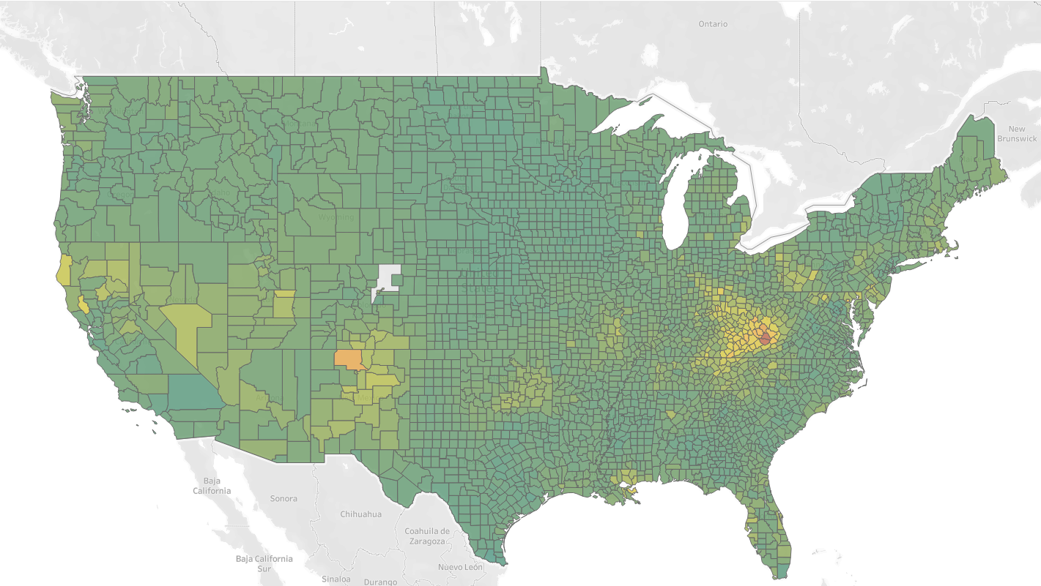
Deaths due to Drug Poisoning
Arjun Doshi (J053) Data Science

Slide 2
This presentation summarises the trends and observations made while analysing the Centres for Disease Control & Prevention’s dataset on Deaths due to Drug Poisoning in the United States of America.
We cover the dataset’s various attributes by taking a top – down approach:
Country -> State -> County and analysing the trends within each.
The main questions answered in this presentation are:
What has the trend of deaths due to drug poisoning been like over the course of a decade?
Where have we seen maximum number of such cases?
What age group/sex is most affected by such deaths?
What classification of county’s are most likely to have maximum number of cases?
After the analysis, a few conclusions could be drawn which will be explained as we proceed.
In the conclusion we uncover reasons for the trends we see in the visualizations and try to rationalise them using proven facts and government documents/analysis.
Data Sets:
Drug-Poisoning-Mortality-by-State-United-States
Drug-Poisoning-Mortality-by-County

Slide 3
What is Drug Poisoning/Toxicity?
Toxicity refers to how poisonous or harmful a substance can be. In the context of pharmacology, drug toxicity occurs when a person has accumulated too much of a drug in his bloodstream, leading to adverse effects on the body.
﻿Drug toxicity may occur when the dose is given is too high or the liver or kidneys are unable to remove the drug from the bloodstream, allowing it to accumulate in the body.
Sources:
Neurotoxicity, Immunotoxicity and Drug Toxicity – A Review

Slide 4
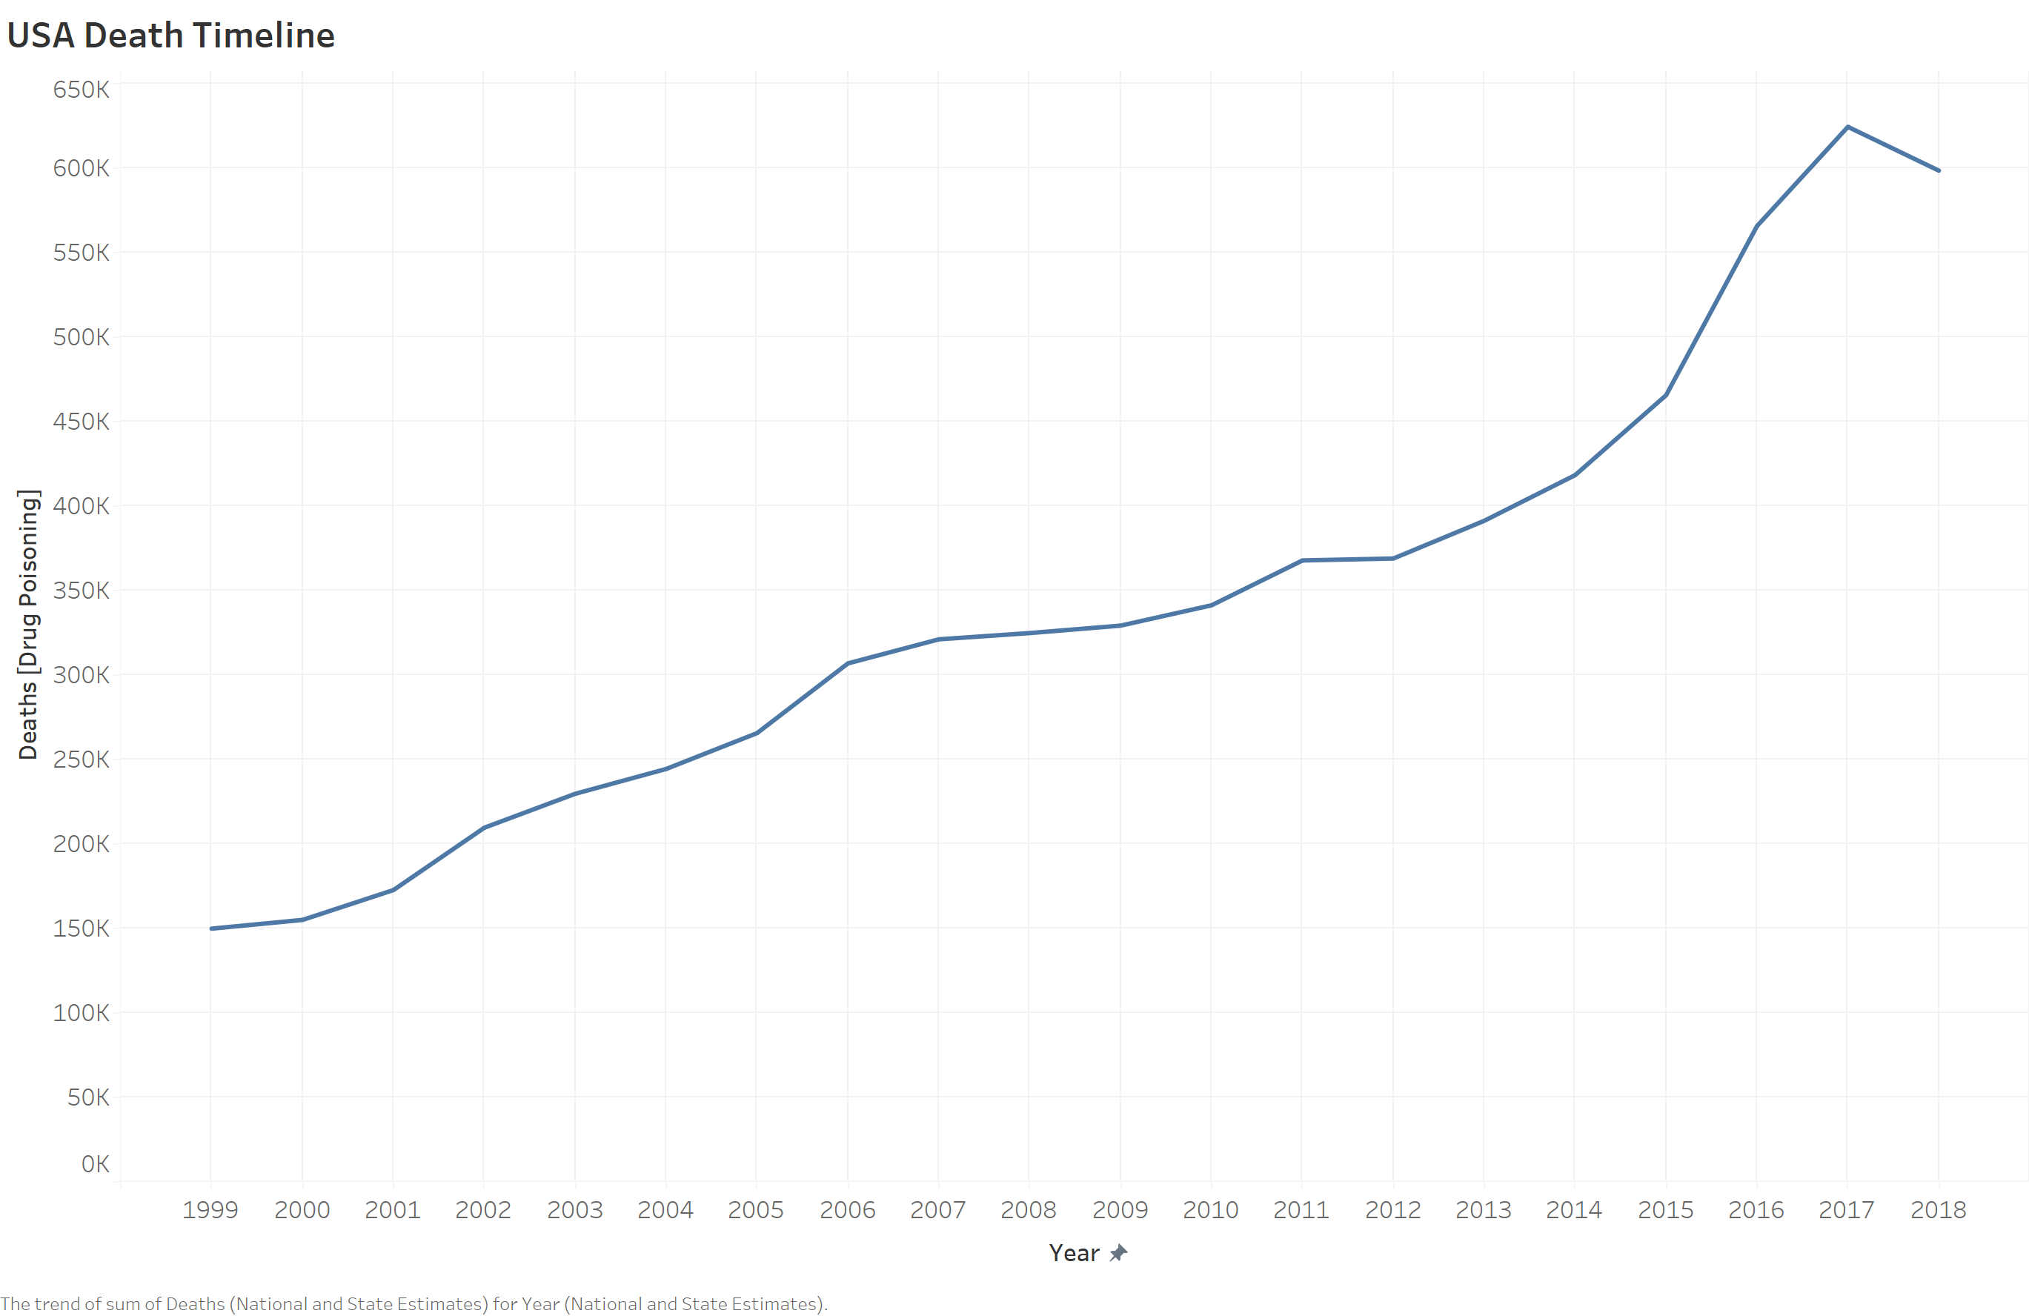
This graph shows a steady increase in the number of deaths over the decade. Although we see a small dip in the numbers for 2018, it is unlikely they will reduce to numbers as seen in 1999.
The reasons for these are mentioned in the conclusion.

Slide 5
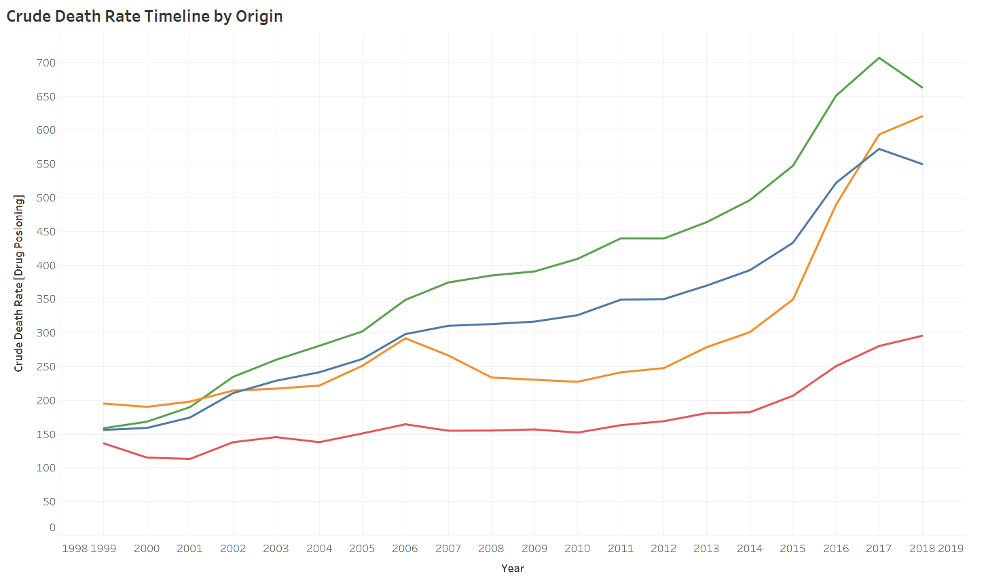
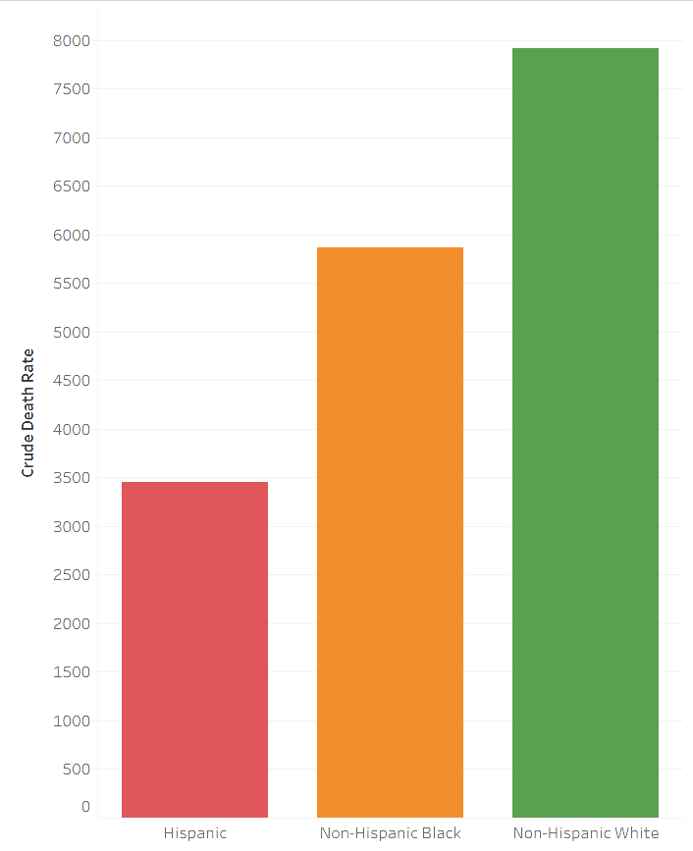
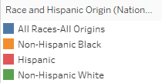
This is a split of the previous timeline showing the cases with respect to the origins.
We can see that Non – Hispanic Whites have the highest sum of death rates.

Slide 6
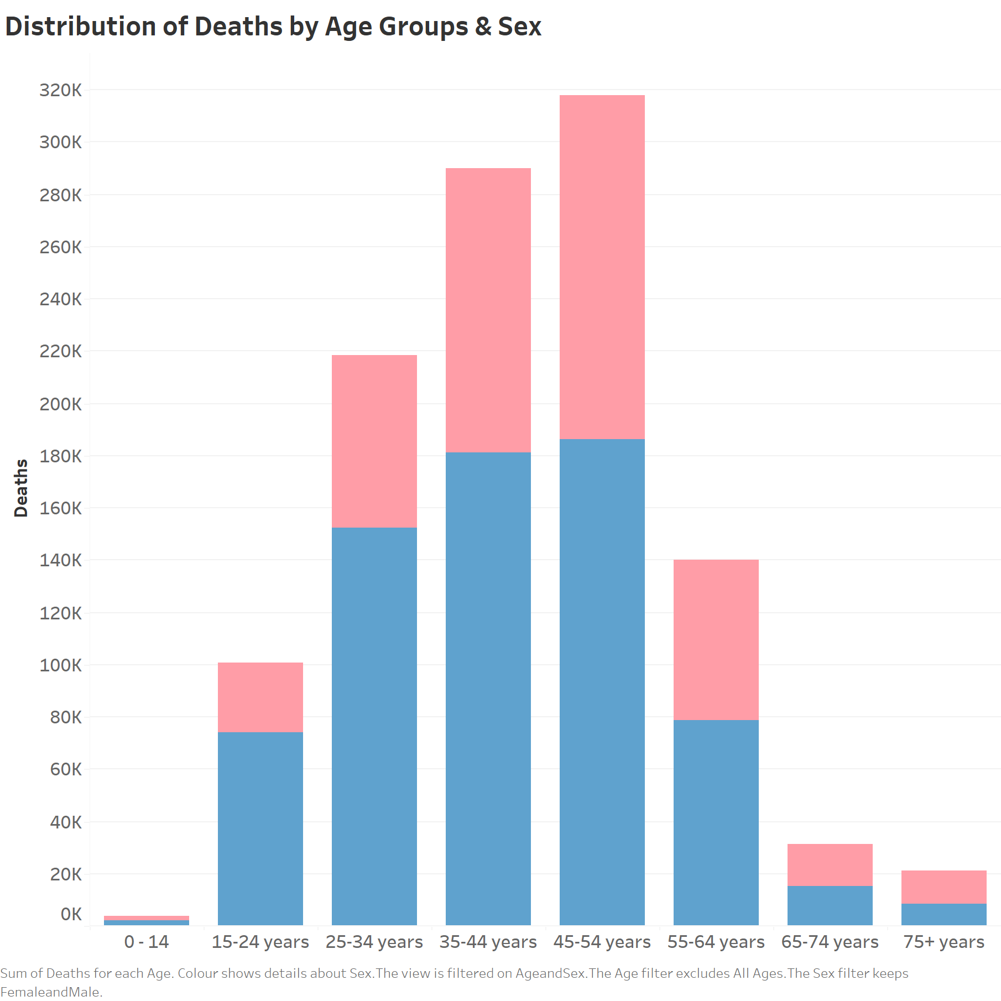
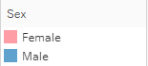
Here we can see the split of the deaths by both age groups and sex. Males have a much larger percentage of deaths as compared to females. We see a gradual rise in such cases with both women and men as age increases.
The only category where women have more deaths than men is the 75+ category.
A few observations using this data are made towards the end, under inferences focusing on the deaths of women.

Slide 7
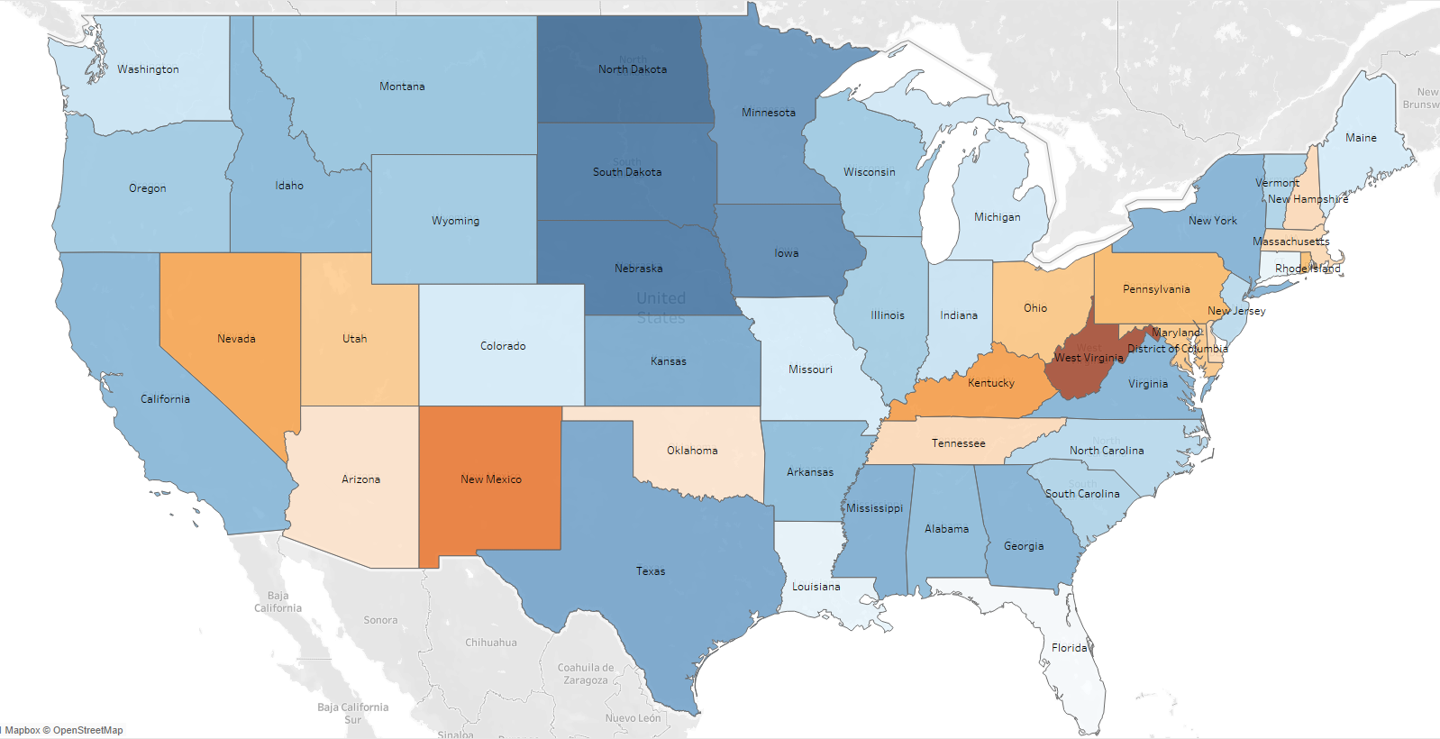
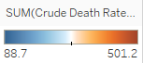
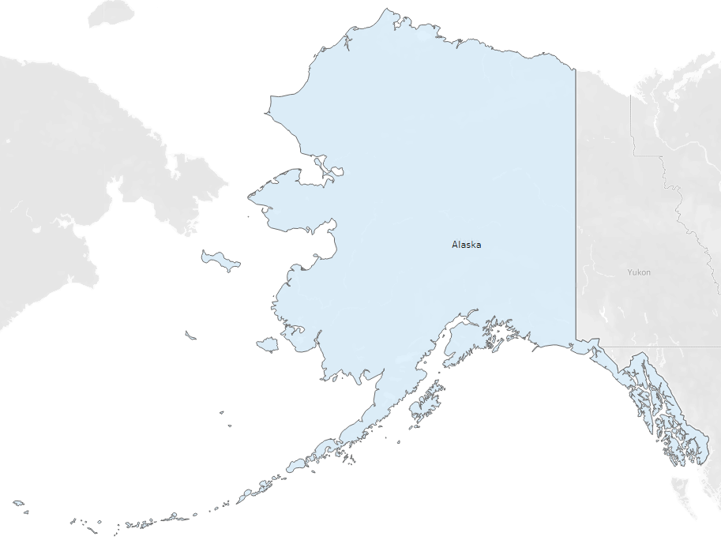
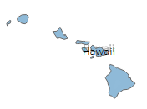
State wise Distribution of Crude Death Rates.

Slide 8
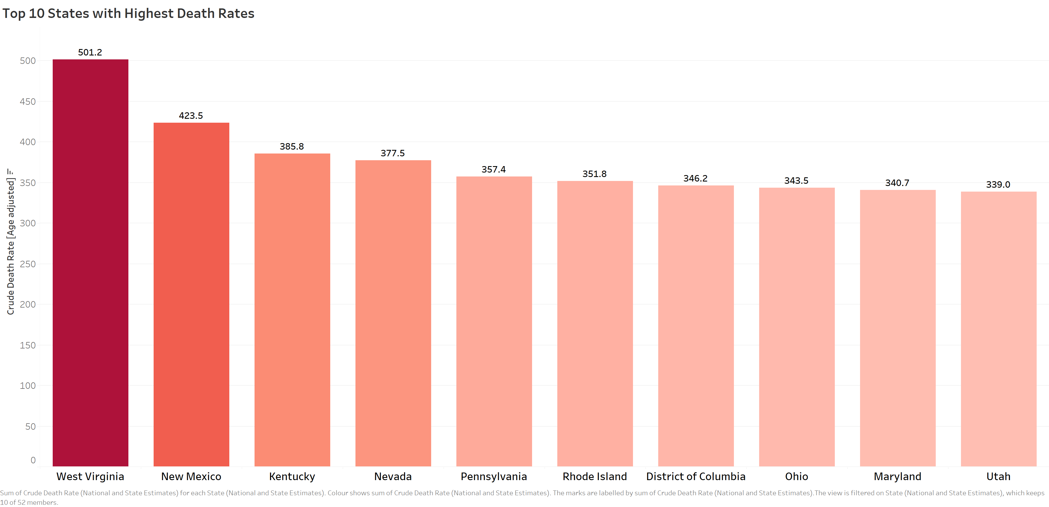
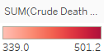
West Virginia has been claiming top spot since 2010/11 which also coincides with when the Obama administration started funding and research for opioids & drug related deaths , followed by New Mexico and Kentucky with overall deaths.

Slide 9
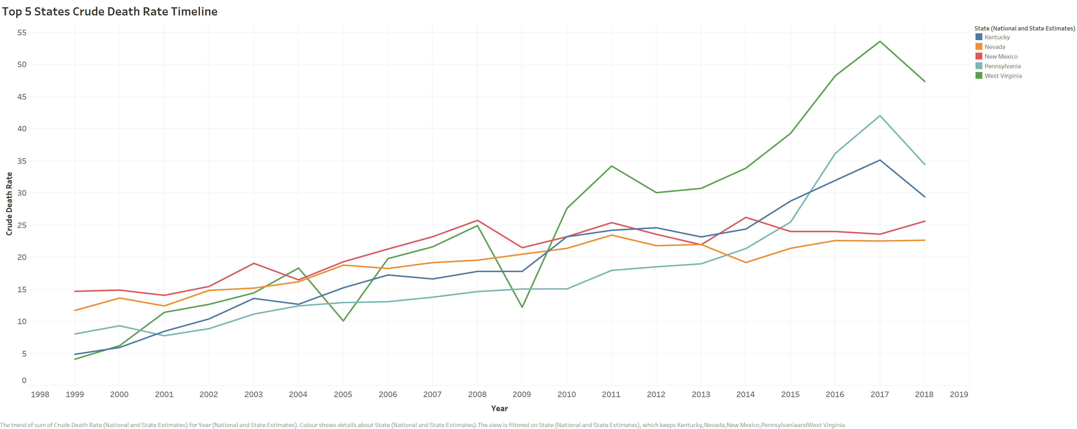
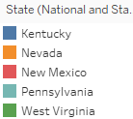
New Mexico started of at the top of the rankings with West Virginia being last but after mid 2009 we see a sharp rise in West Virginia and in 2015 another sharp rise in Pennsylvania which hold the top two ranks in 2018.

Slide 10
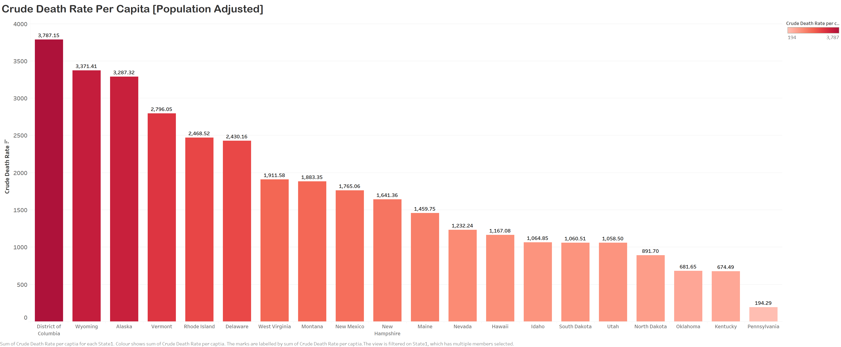
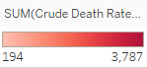
When measuring the deaths per capita (population adjusted) we find the District of Columbia has a very high death rate. It also stands in the 6th position for sum of deaths throughout. West Virginia having an erratic number of cases per year pushes it to 7th in per capita standings.
Pennsylvania although holding 2nd place in 2018 has a very low death rate per capita. This could be because its rise in such cases has been heavily dependent on the post 2015 time frame.

Slide 11
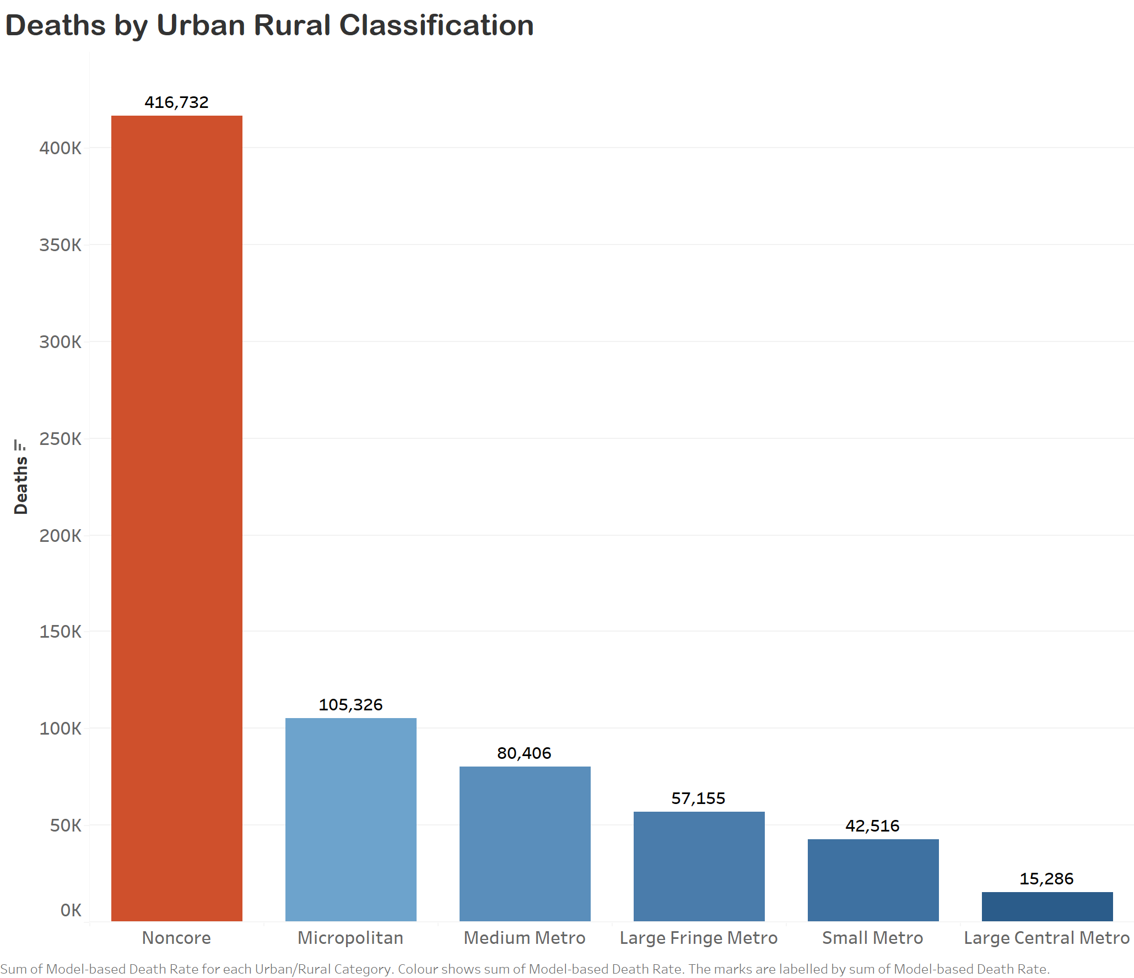
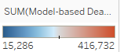
Classification by Urban/Rural areas shows that Noncore areas have a much larger number of death rates.
Non-core counties are nonmetropolitan counties that are not in a micropolitan statistical area which is followed after.
An in depth analysis of each of these categories is done in the next few slides. This allows us to see different types of areas in descending order with greater scrutiny.
This also enables us to build a generic profile for maximum cases as seen with West Virginia later.

Slide 12
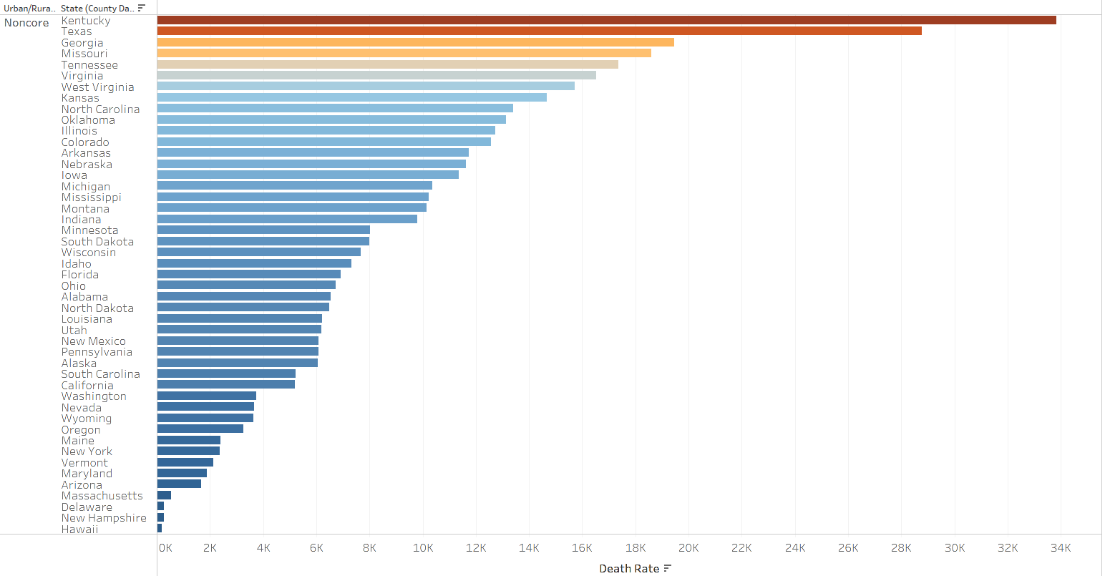
Among Non Core counties by state, we see Kentucky with the highest death rates

Slide 13
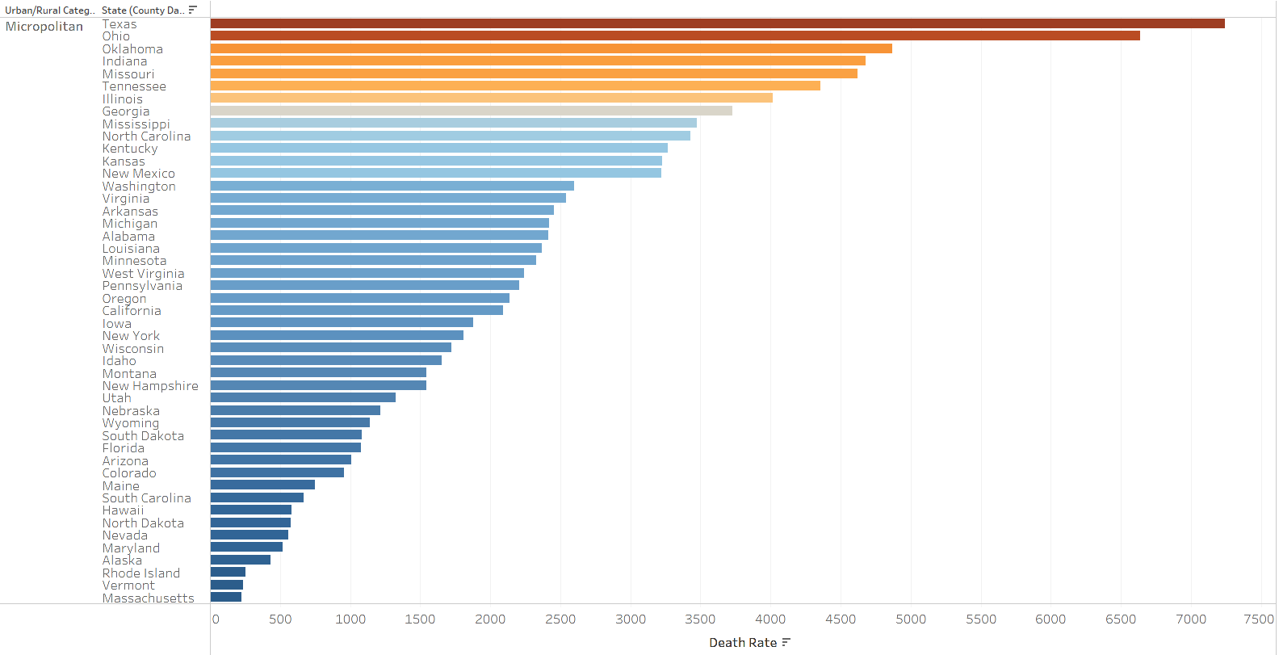
Among Micropolitan counties by state, we see Texas with the highest death rates.

Slide 14
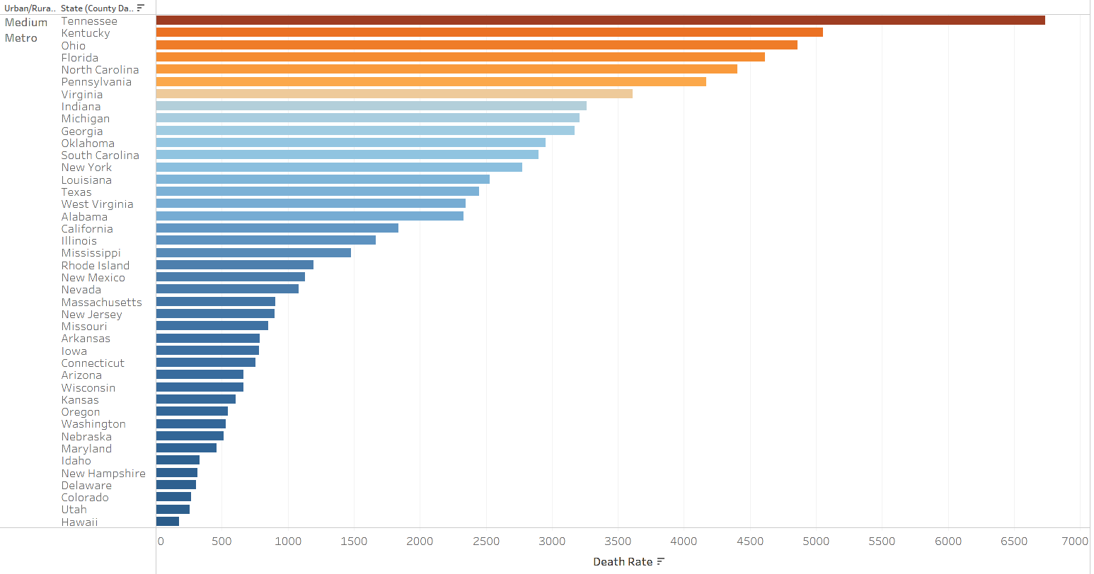
Timeline
Among Medium Metro counties by state, we see Tennessee with the highest death rates followed by Kentucky

Slide 15
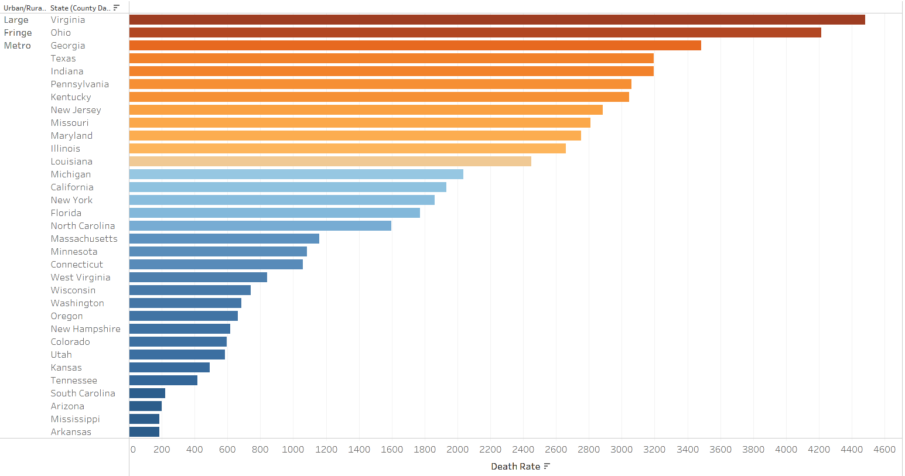
Among Large Fringe Metro counties by state, we see Virginia with the highest death rates.

Slide 16
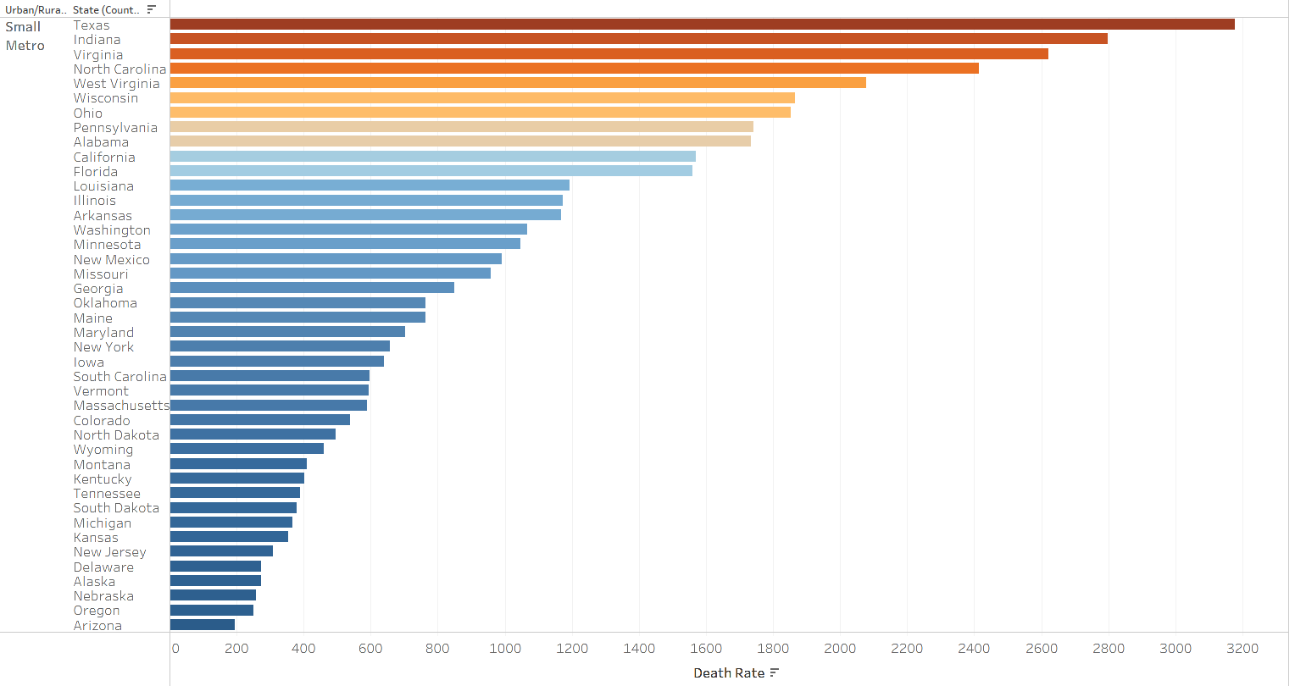
Timeline
Among Small Metro counties by state, we see Texas with the highest death rates

Slide 17
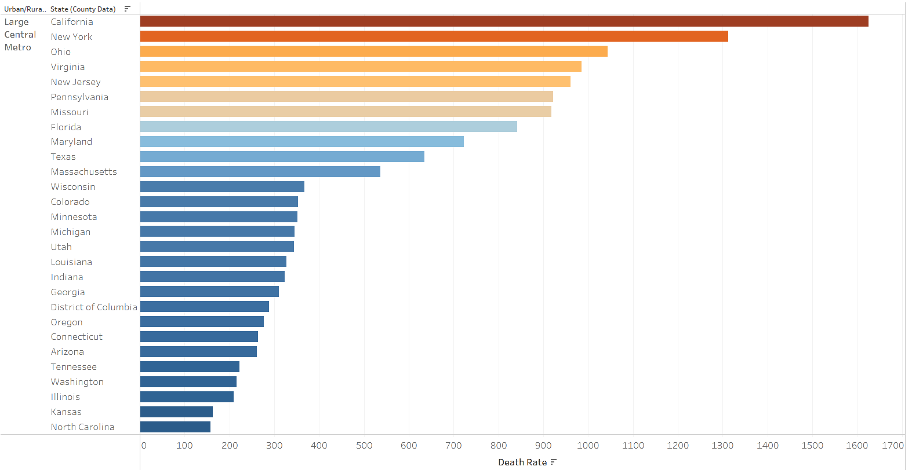
Among Large Central Metro counties by state, we see California with the highest death rates albeit much lesser in comparison to noncore counties.

Slide 18
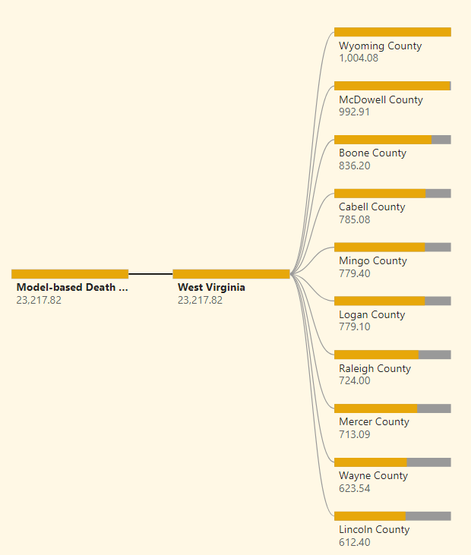
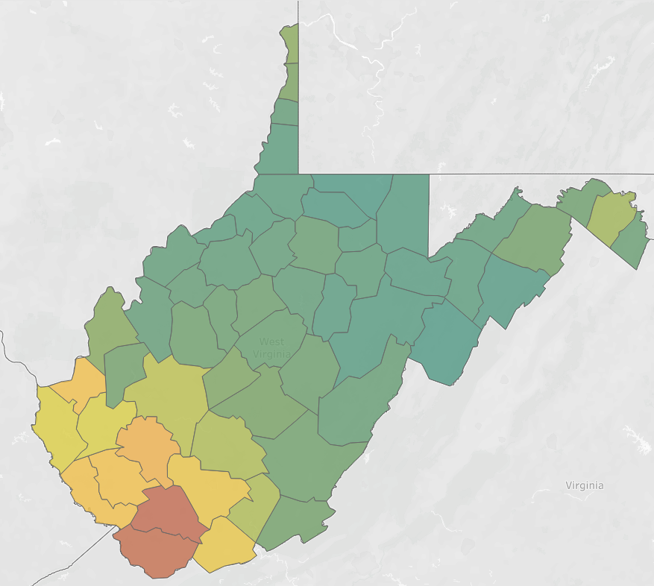
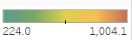
West Virginia County Analysis
Among the various county’s we see that the top 2 are Wyoming and McDowell. Further analysis would be able to justify the major reasons for these two county’s having such high death rates.

Slide 19
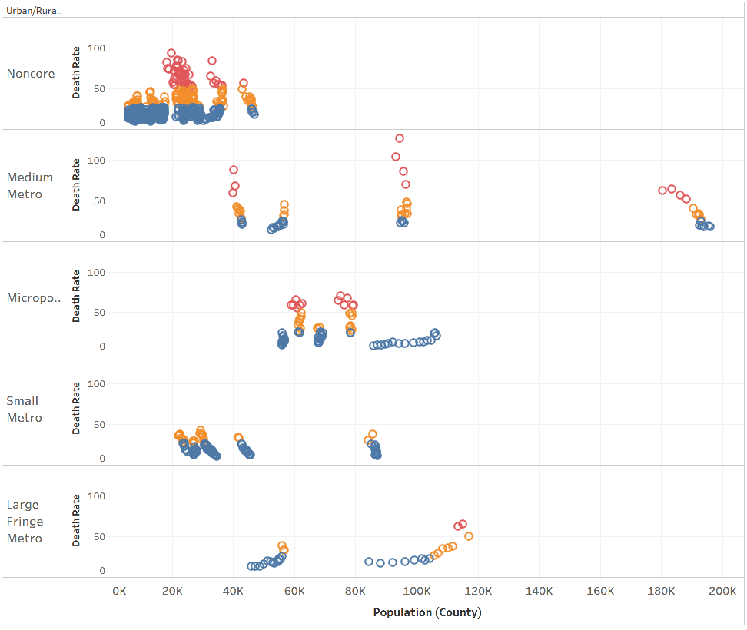
.
West Virginia County Analysis
Among the various county classifications we see that the red clusters show maximum death rates within the urban/rural splits.
Noncore counties with lower population has the maximum number of counties between (50 – 100), making it the most apt profile.
We also see some very high death rates (<100) and a few between (50 – 100) in upper lower and medium population, medium metro counties.

Slide 20
West Virginia County Analysis
According to the West Virginia Health Statistics Centre, opioid-related overdose deaths climbed steadily from 147 in 2001 to 628 in 2015. The overdose death total peaked in Wyoming County in 2011 with 26 fatalities.
“I think it’s due to enforcement, and doctors have eased up on writing so many prescriptions.”
With fewer prescriptions, fewer opioid drugs are available on the streets, which has caused many areas to see an uptick in heroin sales and use. Parker said in the county’s last drug roundup, several heroin-related charges were made.
“Coal is all Wyoming County has ... We have nothing else in Wyoming County.”
Many residents have lived in the county their entire lives. They don’t want to leave their families or their homes, but their frustration grows as they are unable to find work.
“The frustration not being able to find a good job has a lot to do with drug problems in West Virginia,” he said. “If people were working, I don’t think drugs would be as bad.”
This goes to show that unemployment has played an indirect role in affecting death rates. Further we see how the drug business has turned into a family run business.
Data Sets:
www.register-herald.com

Slide 21
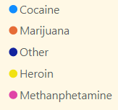
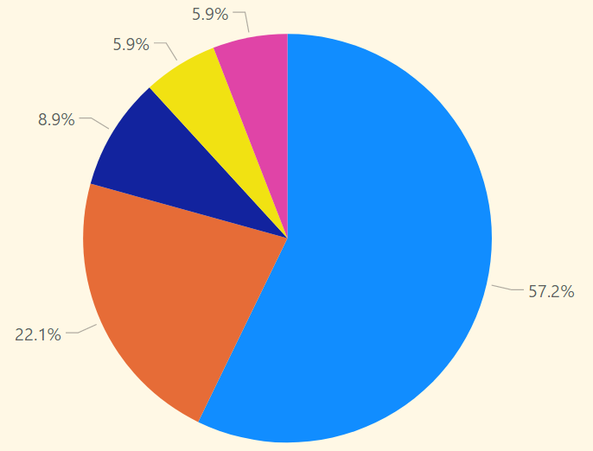
Law enforcement officials report that drug transporters primarily use private and commercial vehicles to transport illicit drugs into and through West Virginia. Drugs available in West Virginia typically are transported into the state from Illinois, Kentucky, Maryland, Michigan, New York, North Carolina, Ohio, Pennsylvania, Virginia, and Washington, D.C. Drugs also are transported from Mexico and other states, although to a lesser extent.
Diverted pharmaceuticals pose a serious drug threat to West Virginia, rivalling that of cocaine in many areas of the state. Further, treatment data indicate that there were more pharmaceutical-related treatment admissions in 2000 than admissions for any illicit drug except marijuana.
As time progressed the situation seemed to get worse resulting in the situation the state has landed itself in. Further we shall see more recent overall findings related to the opioid crisis.
2003 (pre - opioid crisis)
Source:
www.justice.gov.pdf
This document may contain dated information. It has been made available to provide access to historical materials.

Slide 22
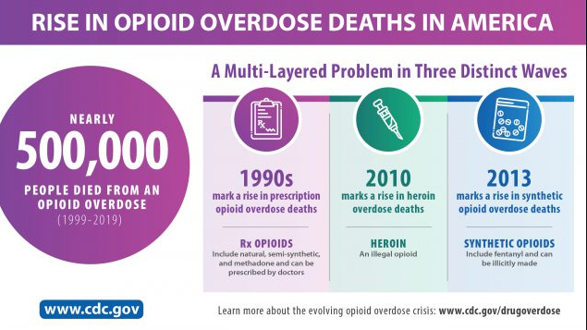
Inferences
Those addicted to opioids, both legal and illegal, are increasingly young, white, and female, with 1.2 million women addicted compared to 0.9 million men in 2015. The problem is worse in rural areas (noncore). Teen use of opioids has been noticeably increasing since 2006 using prescription drugs more than any illicit drug except cannabis; more than cocaine, heroin, and methamphetamine combined.
On May 3, 2021, the city of Huntington, West Virginia filed a lawsuit against three major drug manufacturers accusing them of their role in stoking the opioid crisis through their excessive shipment of painkillers.
Sources:
lawsuits-filed-against-drug-distributors-in-west-virginia

Slide 23
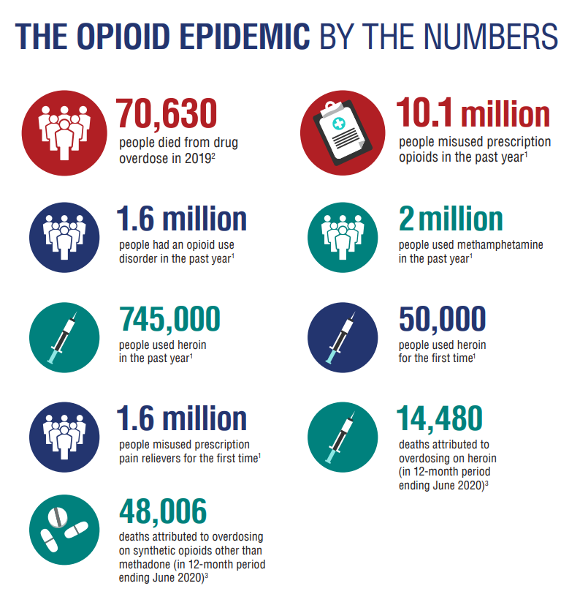
Inferences
This issue has become a public health crisis with devastating consequences including increases in opioid misuse and related overdoses, as well as the rising incidence of neonatal abstinence syndrome due to opioid use and misuse during pregnancy.
The increase in injection drug use has also contributed to the spread of infectious diseases including HIV and hepatitis C. As seen throughout the history of medicine, science can be an important part of the solution in resolving such a public health crisis.
Sources:
US Department of Health Services

Slide 24
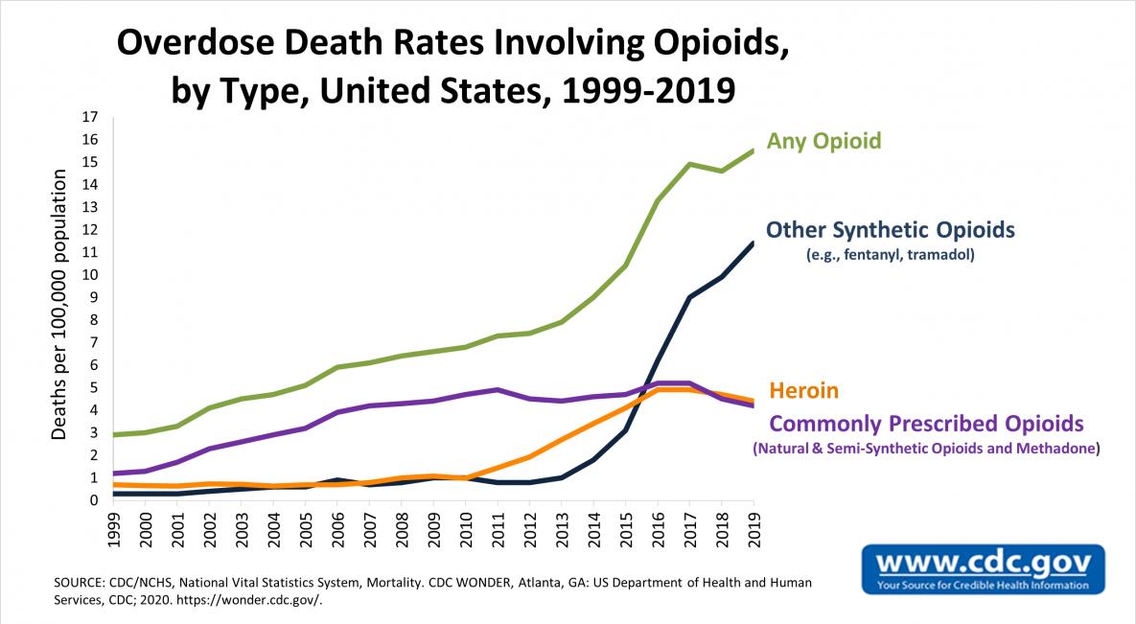
Inferences
Note: Image from CDC

Slide 25
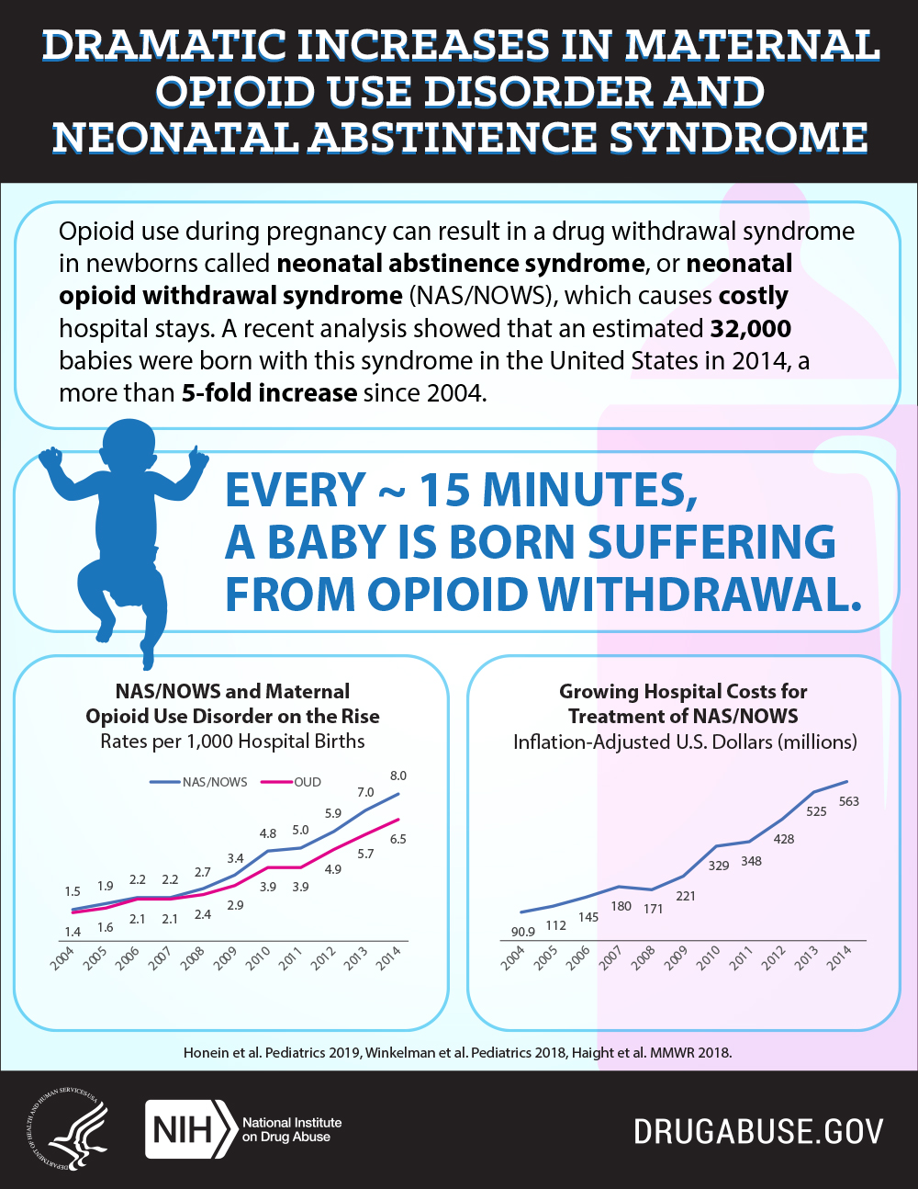
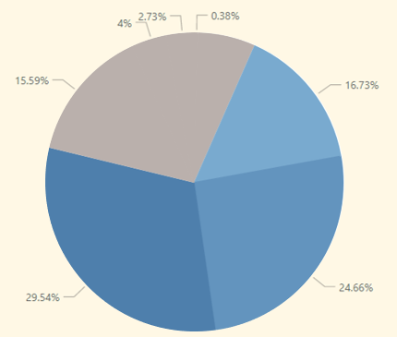
Inferences
Given our findings that majority percentage of women related drug toxicity deaths lie within the (25 – 54),and total majority in (25 – 44) (41.39%) the risk of neonatal abstinence syndrome is becoming a major risk for future generations.
Women deaths total
0 – 24
(22.7%)
25 - 34
45 - 54
35 - 44
Sources:
HHS-response 5 Point Strategy

Slide 26
Methods to Improve
In 2017, HHS launched a comprehensive 5-Point Strategy to empower local communities on the frontlines. The aim of the 5 point strategy is:
Prevention, Treatment, Recovery
Improve access to prevention, treatment, and recovery support services to prevent the health, social, and economic consequences associated with opioid misuse and addiction, and to enable individuals to achieve long-term recovery.
Better Data
Strengthen public health data reporting and collection to improve the timeliness and specificity of data, and to inform a real-time public health response as the epidemic evolves.
Better Pain Management
Advance the practice of pain management to enable access to high-quality, evidence-based pain care that reduces the burden of pain for individuals, families, and society while also reducing the inappropriate use of opioids and opioid-related harms.
Better Research
Support cutting-edge research that advances our understanding of pain, overdose and addiction, leads to the development of new treatments, and identifies effective public health interventions to reduce opioid-related health harms.
Sources:
HHS-response 5 Point Strategy
fivepoint-strategy.pdf

Slide 27
Thank You!

